Slide 1
Difference between Generalization and Specialization in DBMS

Slide 2
Generalization :
It works on the principle of bottom up approach. In Generalization lower level functions are combined to form higher level function which is called as entities.
This process is repeated further to make advanced level entities.
In the Generalization process properties are drawn from particular entities and thus we can create generalized entity.
We can summarize Generalization process as it combines subclasses to form superclass.
Example of Generalization – Consider two entities Student and Patient. These two entities will have some characteristics of their own.
For example Student entity will have Roll_No, Name and Mob_No while patient will have PId, Name and Mob_No characteristics.
Now in this example Name and Mob_No of both Student and Patient can be combined as a Person to form one higher level entity and this process is called as Generalization Process.

Slide 3
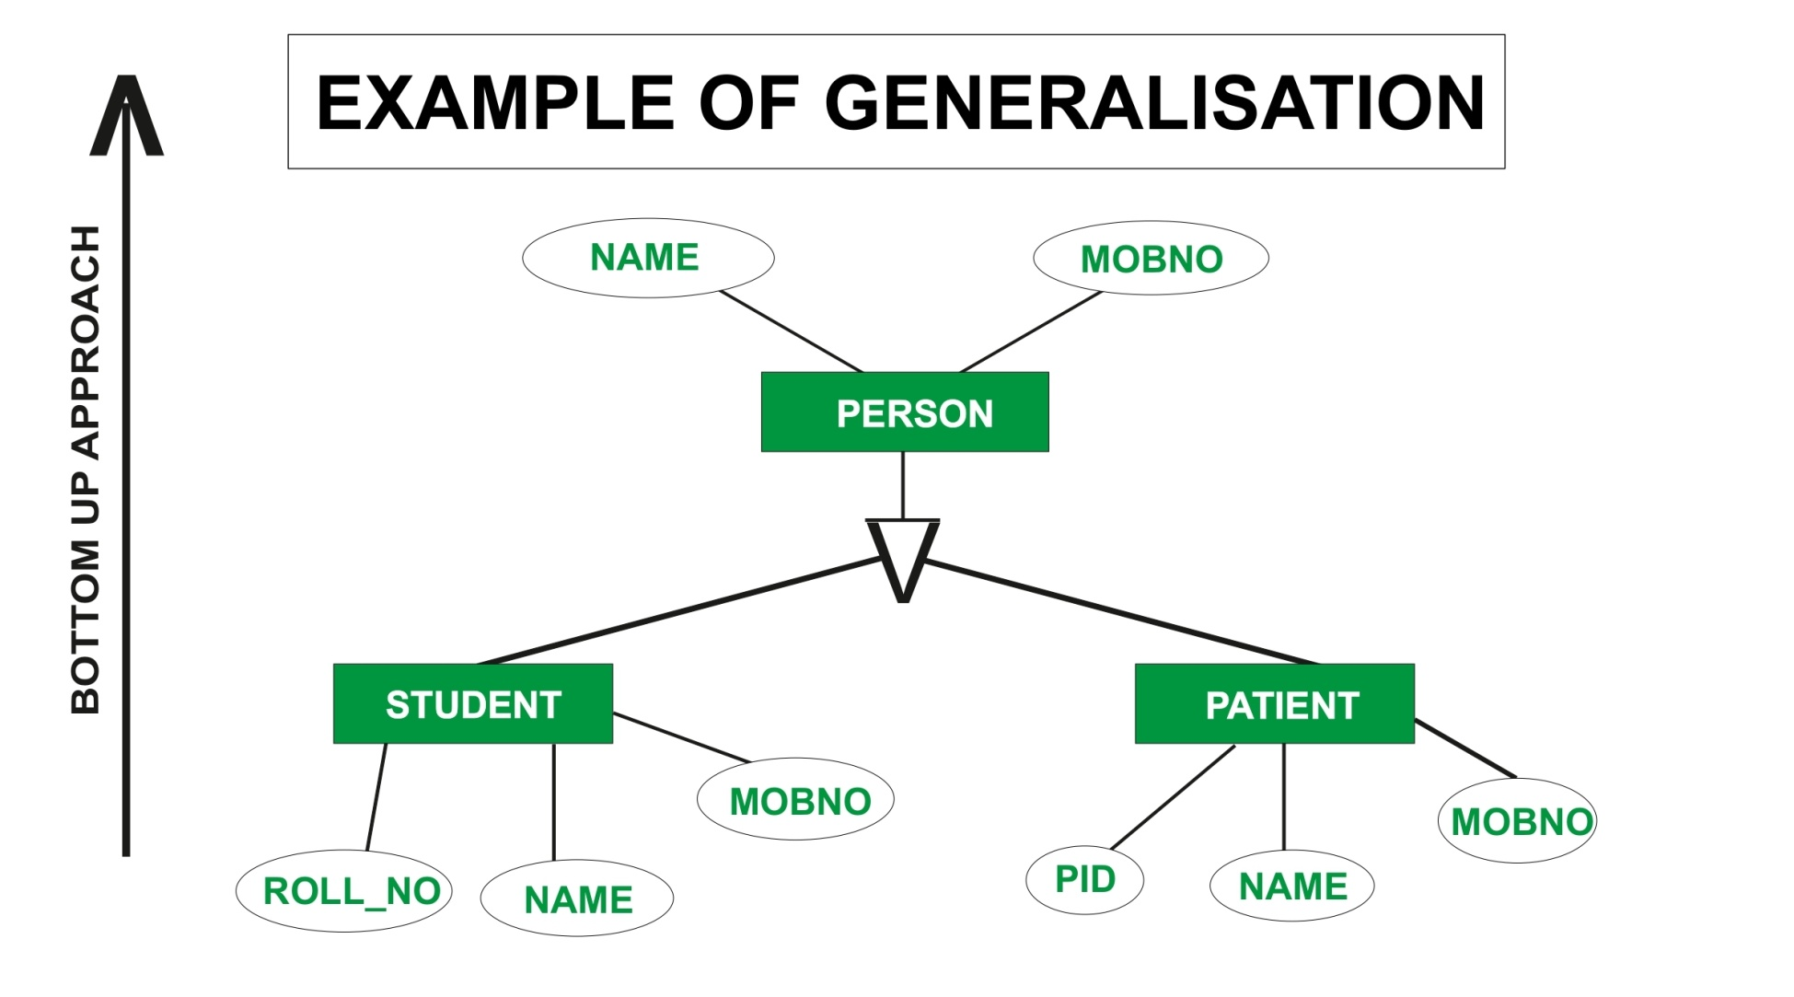

Slide 4
Specialization :
We can say that Specialization is opposite of Generalization.
In Specialization things are broken down into smaller things to simplify it further.
We can also say that in Specialization a particular entity gets divided into sub entities and it’s done on the basis of it’s characteristics.
Also in Specialization Inheritance takes place.
Example of Specialization – Consider an entity Account.
This will have some attributes consider them Acc_No and Balance.
Account entity may have some other attributes like Current_Acc and Savings_Acc. Now Current_Acc may have Acc_No, Balance and Transactions while Savings_Acc may have Acc_No, Balance and Interest_Rate henceforth we can say that specialized entities inherits characteristics of higher level entity.

Slide 5
